Slide 1


SOCIAL MEDIA VIGILANCE SYSTEM
Detecting Hate Speech In Multimodal Memes
PRESENTED BY
Parth Nautiyal and Sachin Sajwan

Slide 2

1 | Introduction
2 | Problem Statement
3 | Objectives
4 | Methodology
5 | Results and Discussion
6 | Conclusion
7 | Future Work
AGENDA

Slide 3



INTRODUCTION
Hateful memes pose challenges to online platforms, spreading hate speech and discrimination. To maintain a safe digital environment, effective detection and moderation systems are necessary. These systems automatically identify and flag harmful content, enabling swift action against toxic behavior.
The development of an effective hateful meme detection system is an ongoing challenge due to the evolving nature of hateful content. Continuous updates and refinements of detection algorithms are essential to keep up with emerging trends and ensure effective identification of harmful content.
03

Slide 4

PROBLEM STATEMENT
Classify memes as hateful or non-hateful
Challenge 1 : | A model that can classify memes as hateful or benign considering visual and textual aspects of memes.
Challenge 2: | Detect hate speech in the form of memes (Text or images) or sarcasm and to measure multimodal progress and understanding by only using Machine Learning classifiers which help to develop better classifiers in the future
04

Slide 5



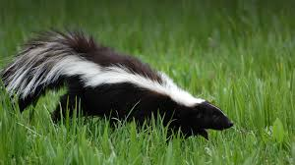


OBJECTIVES
Objective 1 : | Detects hate speech in posts (Text or images).
Objective 2: | Extract text from an image uploaded on platform
Objective 3: | Detects hate speech in the form of sarcasm and memes.
05

Slide 6
METHODOLOGY
Classification of hateful memes that uses supervised and Neural Network Machine Learning Algorithms. Feature Extraction Text Pre-Processing Classification Model
06

Slide 7
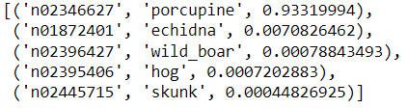
Feature Extraction
Inceptionv3
Features
Image
06

Slide 8
TEXT PREPROCESSING
Text+features
Encode tokens
Padding
Add Attention Mask
Bert
Text Preprocessing
06

Slide 9
Classification Model
Logistics Regression: Logistic regression is a popular statistical modeling technique used for binary classification problems.
It is a type of regression analysis where the dependent variable is categorical (binary) rather than continuous. The goal of logistic
regression is to estimate the probability of an event or outcome occurring based on a set of independent variables.
Support Vector Machines (SVMs) are powerful and versatile machine learning algorithms used for both classification and
regression tasks. SVMs are particularly effective in handling complex decision boundaries and handling high-dimensional data
Random Forest is a versatile algorithm that combines the strengths of decision trees and ensemble learning. It offers high accuracy
robustness, and the ability to handle complex datasets. These qualities make Random Forest a popular choice for a wide range of
machine learning problems.
KNN is a versatile and intuitive algorithm that can be applied to various domains and problems. It is relatively easy to understand and
implement, making it a good choice for getting started with machine learning tasks.However, its computational complexity grows with
the size of the training data, so it may not be suitable for large-scale datasets.
ANN provide a flexible and scalable approach to machine learning, capable of learning from data and extracting meaningful patterns.
Their ability to handle complex relationships and adapt to different problem domains has made them a valuable tool in modern AI applications.
Long short-term memory:Long Short-Term Memory (LSTM) is a type of recurrent neural network (RNN) architecture that is specifically
designed to handle the challenges of learning and predicting patterns in sequential data. LSTMs excel in capturing long-term dependencies and
have become widely used in various applications, including natural language processing, speech recognition, and time series analysis
06

Slide 10
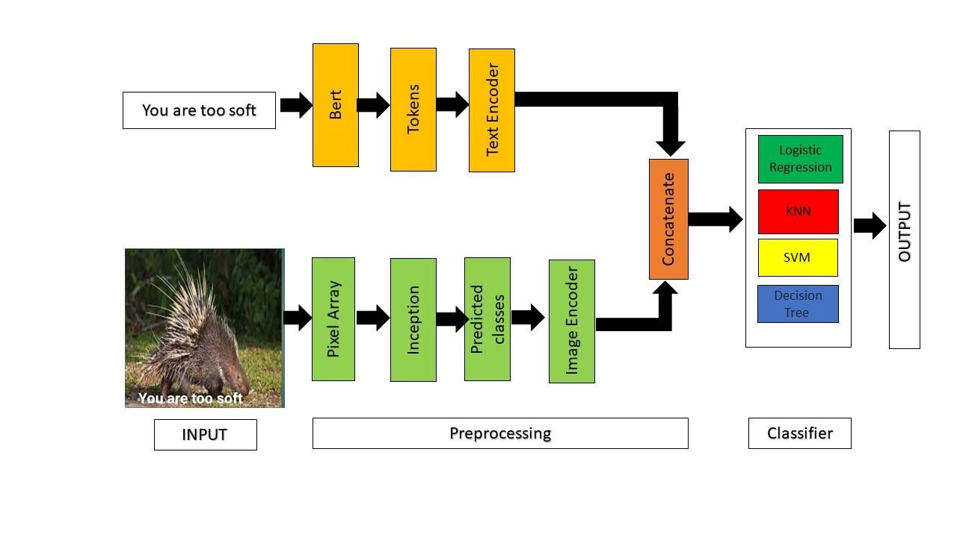
MODEL ARCHITECTURE
Proposed Architecture for Classification of Multimodal meme
06

Slide 11
RESULTS AND DISCUSSION
Classification of hateful memes that uses supervised Machine Learning Algorithms. Evaluation Metrics Area Under the Receiver Operating Characteristics (AUROC) Classification Accuracy Confusion Metrices 2. User Interface of the model
07

Slide 12
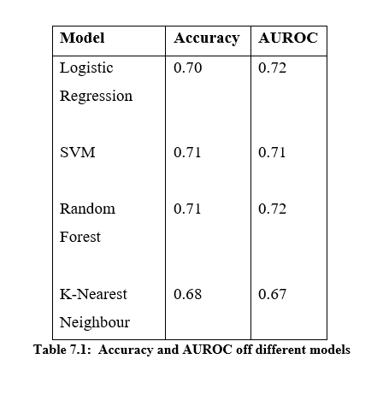
EVALUATION METRICS :
AUROC (Area Under the Receiver Operating Characteristics)
Achieved the AUROC score of 0.72
06

Slide 13
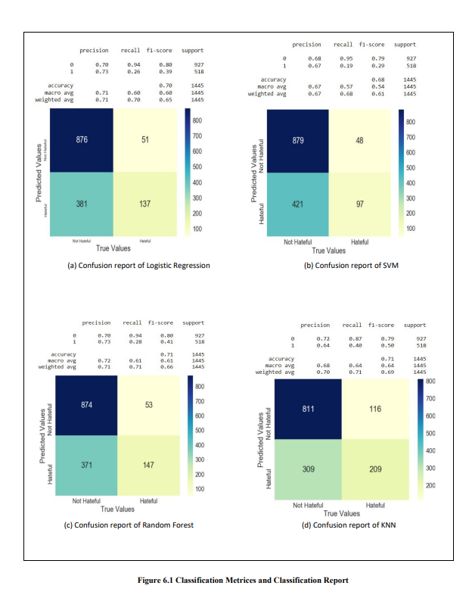
EVALUATION METRICS :
Confusion Metrices
A confusion matrix lists how many of the model's predictions were accurate and how many were wrong.
06

Slide 14
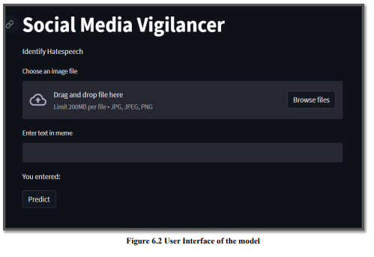
USER INTERFACE OF THE MODEL
06

Slide 15
CONCLUSION AND FUTURE WORK
The model can be used for the classification of multimodal memes. Hence the supervised algorithms can be trained for state-of-the-art performance. We can further optimize the model by training it on a larger dataset or by using Object detection and Sentiment Analysis for capturing more details. It's crucial to effectively combine sentiment and picture captioning so that their distinct impacts are neutralized. Fusion plays a crucial role in this endeavor; hence we intend to investigate additional concatenation methods using attention mechanisms, transformers, etc. Additionally, we think that giving 'Internet Knowledge' via a graphical approach and leveraging other large-scale pretrained multi-modal models like UNITER are other relevant research problems in this endeavor.
06

Slide 16
THANK YOU
06

